Slide 1
Chapter 12: Pointers, Classes, Virtual Functions, and Abstract Classes
Notes:
1

Slide 2
Objectives
In this chapter, you will:
Use the pointer data type and pointer variables
Declare and manipulate pointer variables
Learn about the address of operator and the dereferencing operator
Discover dynamic variables
Use the new and delete operators to manipulate dynamic variables
Learn about pointer arithmetic
C++ Programming: From Problem Analysis to Program Design, Sixth Edition
2
Notes:
2

Slide 3
Objectives (cont’d.)
In this chapter, you will (cont’d.)
Discover dynamic arrays
Explore shallow and deep copies of data
Discover the peculiarities of classes with pointer member variables
Learn about virtual functions
Examine the relationship between the address of operator and classes
Become aware of abstract classes
C++ Programming: From Problem Analysis to Program Design, Sixth Edition
3
Notes:
3

Slide 4
Pointer Data Type and Pointer Variables
Pointer variable: content is a memory address
No name associated with the pointer data type in C++
C++ Programming: From Problem Analysis to Program Design, Sixth Edition
4
Notes:
As in many other languages, there is no name associated with the pointer data type in
C++. Because the domain—that is, the set of values of a pointer data type—is the
addresses (memory locations), a pointer variable is a variable whose content is an address,
that is, a memory location.
4

Slide 5

Declaring Pointer Variables
Syntax:
Examples:
int *p;
char *ch;
These statements are equivalent:
int *p;
int* p;
int * p;
C++ Programming: From Problem Analysis to Program Design, Sixth Edition
5
Notes:
5

Slide 6
Declaring Pointer Variables (cont’d.)
In the statement:
int* p, q;
Only p is a pointer variable
q is an int variable
To avoid confusion, attach the character * to the variable name:
int *p, q;
int *p, *q;
C++ Programming: From Problem Analysis to Program Design, Sixth Edition
6
Notes:
6

Slide 7
Address of Operator (&)
Address of operator (&):
A unary operator that returns the address of its operand
Example:
int x;
int *p;
p = &x;
Assigns the address of x to p
C++ Programming: From Problem Analysis to Program Design, Sixth Edition
7
Notes:
7

Slide 8
Dereferencing Operator (*)
Dereferencing operator (or indirection operator):
When used as a unary operator, * refers to object to which its operand points
Example:
cout << *p << endl;
Prints the value stored in the memory location pointed to by p
C++ Programming: From Problem Analysis to Program Design, Sixth Edition
8
Notes:
8

Slide 9
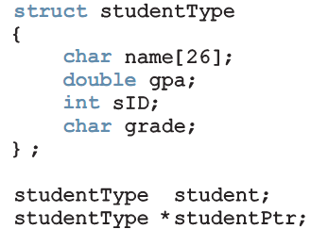
Classes, structs, and Pointer Variables
You can declare pointers to other data types:
student is an object of type studentType
studentPtr is a pointer variable of type studentType
C++ Programming: From Problem Analysis to Program Design, Sixth Edition
9
Notes:
9

Slide 10
Classes, structs, and Pointer Variables (cont’d.)
To store address of student in studentPtr:
studentPtr = &student;
To store 3.9 in component gpa of student:
(*studentPtr).gpa = 3.9;
( ) used because dot operator has higher precedence than dereferencing operator
Alternative: use member access operator arrow (->)
C++ Programming: From Problem Analysis to Program Design, Sixth Edition
10
Notes:
10

Slide 11

Classes, structs, and Pointer Variables (cont’d.)
Syntax to access a class (struct) member using the operator -> :
Thus,
(*studentPtr).gpa = 3.9;
is equivalent to:
studentPtr->gpa = 3.9;
C++ Programming: From Problem Analysis to Program Design, Sixth Edition
11
Notes:
C++ provides another operator called the member
access operator arrow, ->. The operator -> consists of two consecutive symbols: a
hyphen and the ‘‘greater than’’ sign.
11

Slide 12
Initializing Pointer Variables
C++ does not automatically initialize variables
Pointer variables must be initialized if you do not want them to point to anything
Initialized using the null pointer: the constant value 0
Or, use the NULL named constant
The number 0 is the only number that can be directly assigned to a pointer variable
C++ Programming: From Problem Analysis to Program Design, Sixth Edition
12
Notes:
12

Slide 13
Dynamic Variables
Dynamic variables: created during execution
C++ creates dynamic variables using pointers
new and delete operators: used to create and destroy dynamic variables
new and delete are reserved words in C++
C++ Programming: From Problem Analysis to Program Design, Sixth Edition
13
Notes:
In the previous sections, you learned how to declare pointer variables, how to store the address of a variable into a pointer variable of the same type as the variable, and how to manipulate data using pointers. However, you learned how to use pointers to manipulate data only into memory spaces that were created using other variables. In other words, the pointers manipulated data into existing memory spaces. So what is the benefit to using In
particular, you will learn how to allocate and deallocate memory during program execution using pointers. Variables that are created during program execution are called dynamic variables.
With the help of pointers, C++ creates dynamic variables. C++ provides two operators, new and delete , to create and destroy dynamic variables, respectively. When a program requires a new variable, the operator new is used. When a program no longer needs a dynamic variable, the operator delete is used.
13

Slide 14
Operator new
new has two forms:
intExp is any expression evaluating to a positive integer
new allocates memory (a variable) of the designated type and returns a pointer to it
The allocated memory is uninitialized
C++ Programming: From Problem Analysis to Program Design, Sixth Edition
14
Notes:
14

Slide 15
Operator new (cont’d.)
Example: p = new int;
Creates a variable during program execution somewhere in memory
Stores the address of the allocated memory in p
To access allocated memory, use *p
A dynamic variable cannot be accessed directly
Because it is unnamed
C++ Programming: From Problem Analysis to Program Design, Sixth Edition
15
Notes:
int *p;
char *name;
string *str; //p is a pointer of type int
//name is a pointer of type char
//str is a pointer of type string
p = new int; //allocates memory of type int
//and stores the address of the
//allocated memory in p
*p = 28; //stores 28 in the allocated memory
name = new char[5]; //allocates memory for an array of
//five components of type char and
//stores the base address of the array in name
strcpy(name, "John"); //stores John in name
str = new string; //allocates FR memory of type string
//and stores the address of the
//allocated memory in str
*str = "Sunny Day";
//stores the string "Sunny Day" in
//the memory pointed to by str
15

Slide 16
Operator delete (cont’d.)
Suppose you have the following declaration:
int *p; //This statement declares p to be a pointer variable of type int . Next, consider the following statements:
p = new int; //Line 1
*p = 54; //Line 2
p = new int; //Line 3
*p = 73; //Line 4
C++ Programming: From Problem Analysis to Program Design, Sixth Edition
16
Notes:
16

Slide 17
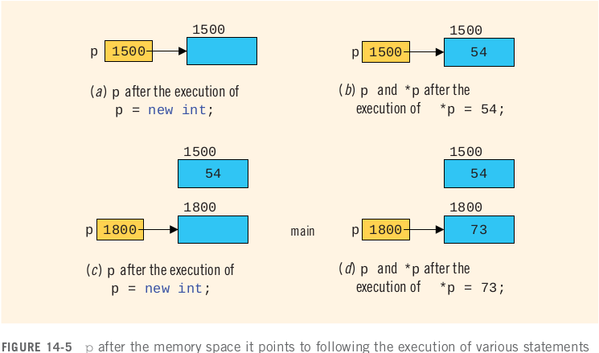
Operator delete (cont’d.)
C++ Programming: From Problem Analysis to Program Design, Sixth Edition
17
Notes:
Next, the statement in Line 3 executes, which allocates a memory space of type int and stores the address of the allocated memory space into p
The previous memory space
at location 1500 is now inaccessible. In addition, the memory space 1500 remains as marked allocated. In other words, it cannot be reallocated. This is called memory leak.
That is, there is an unused memory space that cannot be allocated.
17

Slide 18
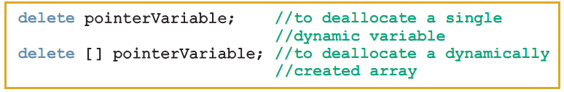
Operator delete (cont’d.)
Memory leak: previously allocated memory that cannot be reallocated
To avoid a memory leak, when a dynamic variable is no longer needed, destroy it to deallocate its memory
delete operator: used to destroy dynamic variables
Syntax:
C++ Programming: From Problem Analysis to Program Design, Sixth Edition
18
Notes:
18

Slide 19
Operator delete (cont’d.)
delete p;
delete [] name;
delete str;
only marks the memory spaces that these pointer variables point to as deallocated.
Depending on a particular system, after these statements execute, these pointer variables may still contain the addresses of the deallocated memory spaces. In this case, we say that these pointers are dangling.
to avoid this pitfall is to set these pointers to NULL after the delete operation.
C++ Programming: From Problem Analysis to Program Design, Sixth Edition
19
Notes:
19

Slide 20
Operations on Pointer Variables
Assignment: value of one pointer variable can be assigned to another pointer of same type
int *p, *q;
p = q; //both p and q point to the same memory location.
Relational operations: two pointer variables of same type can be compared for equality, etc.
Some limited arithmetic operations:
Integer values can be added and subtracted from a pointer variable: p++;// increments the value of p by 4 bytes
Value of one pointer variable can be subtracted from another pointer variable
C++ Programming: From Problem Analysis to Program Design, Sixth Edition
20
Notes:
20

Slide 21
Operations on Pointer Variables (cont’d.)
Pointer arithmetic can be very dangerous:
Program can accidentally access memory locations of other variables and change their content without warning
Some systems might terminate the program with an appropriate error message
Always exercise extra care when doing pointer arithmetic
C++ Programming: From Problem Analysis to Program Design, Sixth Edition
21
Notes:
21

Slide 22
Dynamic Arrays
Dynamic array: array created during program execution
Example:
int *p;
p = new int[10];
*p = 25;
p++; //to point to next array component
*p = 35;
stores 25 into the first memory location
stores 35 into the second memory location
C++ Programming: From Problem Analysis to Program Design, Sixth Edition
22
Notes:
static arrays because their size was fixed at compile time.
One way to handle this limitation is to declare an array that is large enough
On the other hand, it would be helpful if, during program execution, you could prompt the user to enter the size of the array and then create an array of the appropriate size.
22

Slide 23
Dynamic Arrays (cont’d.)
Can use array notation to access these memory locations
Example:
p[0] = 25;
p[1] = 35;
Stores 25 and 35 into the first and second array components, respectively
An array name is a constant pointer
int *intList; //Line 1
int arraySize; //Line 2
cout << "Enter array size: "; //Line 3
cin >> arraySize; //Line 4
cout << endl; //Line 5
intList = new int[arraySize]; //Line 6
C++ Programming: From Problem Analysis to Program Design, Sixth Edition
23
Notes:
23

Slide 24
Functions and Pointers
Pointer variable can be passed as a parameter either by value or by reference
As a reference parameter in a function heading, use &:
void pointerParameters(int* &p, double *q)
{
. . .
}
both p and q are pointers.
The parameter p is a reference parameter;
the parameter q is a value parameter
C++ Programming: From Problem Analysis to Program Design, Sixth Edition
24
Notes:
to declare a formal parameter as a reference pointer parameter,
between the data type name and the identifier name, you must include * to make the
identifier a pointer and & to make it a reference parameter.
24
#include <iostream> using namespace std; int main() { void swap(int*, int*); // Function prototype int a = 1, b = 2; cout << "Before swaping" << endl; cout << "a = " << a << endl; cout << "b = " << b << endl; swap(&a, &b); cout << "\nAfter swaping" << endl; cout << "a = " << a << endl; cout << "b = " << b << endl; return 0; } void swap(int* n1, int* n2) { int temp; temp = *n1; *n1 = *n2; *n2 = temp; }

Slide 25
Functions and Pointers
void InitString1( char* buf )
{
buf = new char[5];
}
//pass by reference
void InitString2( char*& buf )
{
buf = new char[5];
}
int main()
{
char* buffer = 0;
InitString1( buffer);
//buffer is still null and memory leaks
delete [] buffer;
InitString2( buffer );
//buffer will be assigned correctly
delete [] buffer;
return 0;
}
C++ Programming: From Problem Analysis to Program Design, Sixth Edition
25
Notes:
to declare a formal parameter as a reference pointer parameter,
between the data type name and the identifier name, you must include * to make the
identifier a pointer and & to make it a reference parameter.
25
#include <iostream> using namespace std; int main() { void swap(int*, int*); // Function prototype int a = 1, b = 2; cout << "Before swaping" << endl; cout << "a = " << a << endl; cout << "b = " << b << endl; swap(&a, &b); cout << "\nAfter swaping" << endl; cout << "a = " << a << endl; cout << "b = " << b << endl; return 0; } void swap(int* n1, int* n2) { int temp; temp = *n1; *n1 = *n2; *n2 = temp; }

Slide 26
Functions and Pointers
void fun(int a) { printf("Value of a is %d\n", a); } int main() { // fun_ptr is a pointer to function fun() void (*fun_ptr)(int) = &fun; /* The above line is equivalent of following two void (*fun_ptr)(int); fun_ptr = &fun; */ // Invoking fun() using fun_ptr (*fun_ptr)(10); return 0; }
Output:
Value of a is 10
C++ Programming: From Problem Analysis to Program Design, Sixth Edition
26
Notes:
to declare a formal parameter as a reference pointer parameter,
between the data type name and the identifier name, you must include * to make the
identifier a pointer and & to make it a reference parameter.
26
#include <iostream> using namespace std; int main() { void swap(int*, int*); // Function prototype int a = 1, b = 2; cout << "Before swaping" << endl; cout << "a = " << a << endl; cout << "b = " << b << endl; swap(&a, &b); cout << "\nAfter swaping" << endl; cout << "a = " << a << endl; cout << "b = " << b << endl; return 0; } void swap(int* n1, int* n2) { int temp; temp = *n1; *n1 = *n2; *n2 = temp; }

Slide 27
Functions and Pointers
#include <stdio.h> void add(int a, int b) { printf("Addition is %d\n", a+b); } void subtract(int a, int b) { printf("Subtraction is %d\n", a-b); } void multiply(int a, int b) { printf("Multiplication is %d\n", a*b); } int main() { // fun_ptr_arr is an array of function pointers void (*fun_ptr_arr[])(int, int) = {add, subtract, multiply}; unsigned int ch, a = 15, b = 10; printf("Enter Choice: 0 for add, 1 for subtract and 2 " "for multiply\n"); scanf("%d", &ch); if (ch > 2) return 0; (*fun_ptr_arr[ch])(a, b); return 0; }
Enter Choice: 0 for add, 1 for subtract and 2 for multiply 2 Multiplication is 150
C++ Programming: From Problem Analysis to Program Design, Sixth Edition
27
Notes:
to declare a formal parameter as a reference pointer parameter,
between the data type name and the identifier name, you must include * to make the
identifier a pointer and & to make it a reference parameter.
27
#include <iostream> using namespace std; int main() { void swap(int*, int*); // Function prototype int a = 1, b = 2; cout << "Before swaping" << endl; cout << "a = " << a << endl; cout << "b = " << b << endl; swap(&a, &b); cout << "\nAfter swaping" << endl; cout << "a = " << a << endl; cout << "b = " << b << endl; return 0; } void swap(int* n1, int* n2) { int temp; temp = *n1; *n1 = *n2; *n2 = temp; }

Slide 28
Pointers and Function Return Values
A function can return a value of type pointer:
int* testExp(...)
{
. . .
}
C++ Programming: From Problem Analysis to Program Design, Sixth Edition
28
Notes:
28

Slide 29


Dynamic Two-Dimensional Arrays
You can create dynamic multidimensional arrays in various ways:
Examples:
declares board to be an array of four pointers wherein each pointer is of type int
creates the rows of board
board is a two-dimensional array of four rows and six columns
declares board to be a pointer to a pointer
C++ Programming: From Problem Analysis to Program Design, Sixth Edition
29
Notes:
29

Slide 30
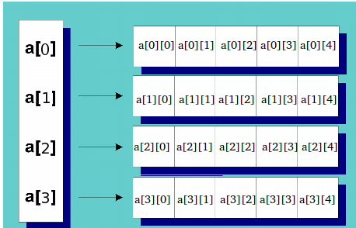
Dynamic Two-Dimensional Arrays
int rowCount = 5, colCount = 4;
int** ary = new int*[rowCount];
for (int i = 0; i < rowCount; ++i)
ary[i] = new int[colCount];
for (int i = 0; i < rowCount; i++)
{
for (int j = 0; j < colCount; j++)
{
ary[i][j] = j;
cout << ary[i][j] << " ";
}
cout << endl;
}
C++ Programming: From Problem Analysis to Program Design, Sixth Edition
30
Notes:
30

Slide 31
Dynamic Two-Dimensional Arrays
#include <iostream>
#include <iomanip>
using namespace std;
int main()
{
int **board; //Line 1
int rows; //Line 2
int columns; //Line 3
cout << "Line 4: Enter the number of rows "
<< "and columns: "; //Line 4
cin >> rows >> columns; //Line 5
cout << endl; //Line 6
//Create the rows of board
board = new int*[rows]; //Line 7
//Create the columns of board
for (int row = 0; row < rows; row++) //Line 8
board[row] = new int[columns]; //Line 9
//Insert elements into board
fill(board, rows, columns); //Line 10
cout << "Line 11: Board:" << endl; //Line 11
//Output the elements of board
print(board, rows, columns); //Line 12
return 0;
}
void fill(int **p, int rowSize, int columnSize)
{
for (int row = 0; row < rowSize; row++)
{
cout << "Enter " << columnSize << " number(s) for row "
<< "number " << row << ": ";
for (int col = 0; col < columnSize; col++)
cin >> p[row][col];
cout << endl;
}
}
void print(int **p, int rowSize, int columnSize)
{
for (int row = 0; row < rowSize; row++)
{
for (int col = 0; col < columnSize; col++)
cout << setw(5) << p[row][col];
cout << endl;
}
}
C++ Programming: From Problem Analysis to Program Design, Sixth Edition
31
Notes:
31

Slide 32


Shallow Versus Deep Copy and Pointers
int *first;
int *second;
first = new int[10]; //creates an array of 10 components, and the base address of the array is stored into first
Suppose that some meaningful data is stored in the array pointed to by first.
second = first; //Line A
delete [] second;
to access the memory pointed to by first,
either the program will access the wrong memory or
it will terminate in an error.
C++ Programming: From Problem Analysis to Program Design, Sixth Edition
32
Notes:
32

Slide 33
Shallow Versus Deep Copy and Pointers
Shallow copy: when two or more pointers of the same types point to the same memory
They point to the same data
Danger: deleting one deletes the data pointed to by all of them
Deep copy: when the contents of the memory pointed to by a pointer are copied to the memory location of another pointer
Two copies of the data
C++ Programming: From Problem Analysis to Program Design, Sixth Edition
33
Notes:
33

Slide 34

Shallow Versus Deep Copy and Pointers
int *first;
int *second;
first = new int[10]; //creates an array of 10 components, and the base address of the array is stored into first
Suppose that some meaningful data is stored in the array pointed to by first.
second = new int[10]; //Line A
for (int j = 0; j < 10; j++)
second[ j ] = first[ j ];
delete [] second; // there is no effect on first.
C++ Programming: From Problem Analysis to Program Design, Sixth Edition
34
Notes:
34

Slide 35

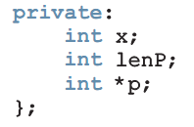
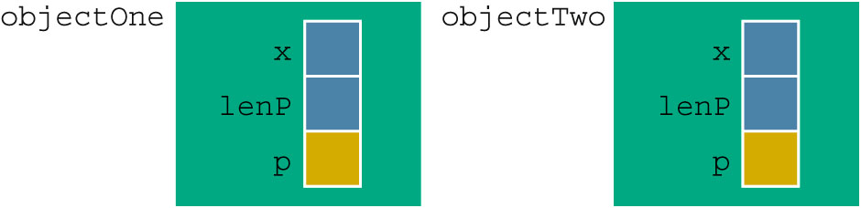

Classes and Pointers: Some Peculiarities
Example class:
Example program statements:
C++ Programming: From Problem Analysis to Program Design, Sixth Edition
35
Notes:
35
In the previous section, we discussed how to use the arrow notation to access class
members via the pointer if a pointer variable is of a class type. Because a class can have
pointer member variables, this section discusses some peculiarities of such classes.

Slide 36

Destructor
If objectOne goes out of scope, its member variables are destroyed
Memory space of dynamic array stays marked as allocated, even though it cannot be accessed
Solution: in destructor, ensure that when objectOne goes out of scope, its array memory is deallocated:
C++ Programming: From Problem Analysis to Program Design, Sixth Edition
36
Notes:
36

Slide 37
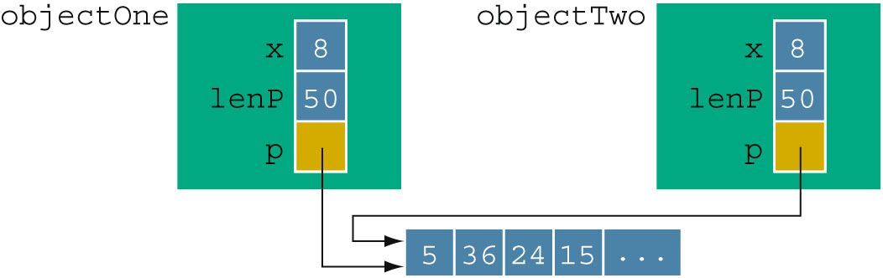
Assignment Operator
limitations of the built-in assignment operators for classes with pointer member variables: objectTwo = objectOne;
After a shallow copy: if objectTwo.p deallocates memory space to which it points, objectOne.p becomes invalid
Solution: extend definition of the assignment operator to avoid shallow copying of data (overloading)
C++ Programming: From Problem Analysis to Program Design, Sixth Edition
37
Notes:
37

Slide 38
Copy Constructor
Default member-wise initialization:
Initializing a class object by using the value of an existing object of the same type
Example:
ptrMemberVarType objectThree(objectOne);
The object objectThree is being declared and is also being initialized by using the value of objectOne.
Copy constructor: provided by the compiler
Performs this initialization
Leads to a shallow copying of the data if class has pointer member variables
C++ Programming: From Problem Analysis to Program Design, Sixth Edition
38
Notes:
38

Slide 39
Copy Constructor (cont’d.)
Similar problem occurs when passing objects by value
Copy constructor automatically executes in three situations:
When an object is declared and initialized by using the value of another object
When an object is passed by value as a parameter
When the return value of a function is an object
C++ Programming: From Problem Analysis to Program Design, Sixth Edition
39
Notes:
39

Slide 40
Copy Constructor (cont’d.)
Solution: override the copy constructor
For classes with pointer member variables, three things are normally done:
Include the destructor in the class
Overload the assignment operator for the class
Include the copy constructor
C++ Programming: From Problem Analysis to Program Design, Sixth Edition
40
Notes:
40

Slide 41
Copy Constructor (cont’d.)
class ptrMemberVarType
{
public:
……
ptrMemberVarType(const ptrMemberVarType& otherObject) //Copy constructor
{
maxSize = otherObject.maxSize;
length = otherObject.length;
p = new int[maxSize];
for (int i = 0; i < length; i++)
p[i] = otherObject.p[i];
}
private:
int maxSize; //variable to store the maximum size of p
int length; //variable to store the number elements in p
int *p; //pointer to an int array
};
C++ Programming: From Problem Analysis to Program Design, Sixth Edition
41
Notes:
41

Slide 42
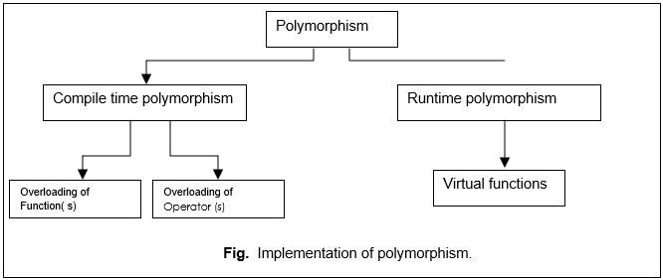
Polymorphim=‘one name multiple forms’
C++ Programming: From Problem Analysis to Program Design, Sixth Edition
42
Notes:
42

Slide 43
Inheritance, Pointers, and Virtual Functions
Can pass an object of a derived class to a formal parameter of the base class type
Compile-time binding: the necessary code to call specific function is generated by compiler
Also known as static binding or early binding
Virtual function: binding occurs at program execution time, not at compile time
Declared with reserved word virtual
C++ Programming: From Problem Analysis to Program Design, Sixth Edition
43
Notes:
43
C++ allows the user to pass an object of a derived class to a
formal parameter of the base class type.

Slide 44
Without Virtual Function
class petType
{
public:
void print();
petType(string ring n = "");
private:
string name;
};
class dogType : public petType
{
public:
void print();
dogType(string n = "", string b = "");
private:
string breed;
};
void callPrint(petType& p)
{ p.print();
}
int main()
{
petType pet("Lucky"); //Line 1
dogType dog("Tommy", "German Shepherd");
//Line 2
pet.print(); //Line 3
cout << endl; //Line 4
dog.print(); //Line 5
cout << "*Calling the function callPrint”
<< endl; //Line 6
callPrint(pet); //Line 7
cout << endl; //Line 8
callPrint(dog); //Line 9
return 0;
}
Name: Lucky
Name: Tommy, Breed: German Shepherd
*** Calling the function callPrint ***
Name: Lucky
Name: Tommy
C++ Programming: From Problem Analysis to Program Design, Sixth Edition
44

Slide 45
With Virtual Function
class petType
{
public:
virtual void print(); //virtual function
petType(string ring n = "");
private:
string name;
};
class dogType : public petType
{
public:
void print();
dogType(string n = "", string b = "");
private:
string breed;
};
void callPrint(petType& p)
{ p.print();
}
int main()
{
petType pet("Lucky"); //Line 1
dogType dog("Tommy", "German Shepherd");
//Line 2
pet.print(); //Line 3
cout << endl; //Line 4
dog.print(); //Line 5
cout << "*Calling the function callPrint”
<< endl; //Line 6
callPrint(pet); //Line 7
cout << endl; //Line 8
callPrint(dog); //Line 9
return 0;
}
Name: Lucky
Name: Tommy, Breed: German Shepherd
*** Calling the function callPrint ***
Name: Lucky
Name: Tommy, Breed: German Shepherd
C++ Programming: From Problem Analysis to Program Design, Sixth Edition
45

Slide 46
Inheritance, Pointers, and Virtual Functions (cont’d.)
Values of a derived class object can be copied into a base class object
Slicing problem: if derived class has more data members than base class, some data could be lost
Solution: use pointers for both base and derived class objects
C++ Programming: From Problem Analysis to Program Design, Sixth Edition
46
Notes:
46

Slide 47
With Virtual Function
class petType
{
public:
virtual void print(); //virtual function
petType(string ring n = "");
private:
string name;
};
class dogType : public petType
{
public:
void print();
dogType(string n = "", string b = "");
private:
string breed;
};
void callPrint(petType *p)
{ p->print();
}
int main()
{
petType *pet = new petType("Lucky");
dogType *dog;
dog=new dogType("Tommy","German Shepherd");
pet->print();
cout << endl;
dog->print();
cout << "*Calling the function callPrint”
<< endl;
callPrint(pet);
cout << endl;
callPrint(dog);
return 0;
}
Name: Lucky
Name: Tommy, Breed: German Shepherd
*** Calling the function callPrint ***
Name: Lucky
Name: Tommy, Breed: German Shepherd
C++ Programming: From Problem Analysis to Program Design, Sixth Edition
47

Slide 48
With Virtual Function
class petType
{
public:
virtual void print(); //virtual function
petType(string ring n = "");
private:
string name;
};
class dogType : public petType
{
public:
void print();
dogType(string n = "", string b = "");
private:
string breed;
};
void callPrint(petType p)
{ p->print();
}
int main()
{
petType *pet = new petType("Lucky");
dogType *dog;
dog=new dogType("Tommy","German Shepherd");
pet->print();
cout << endl;
dog->print();
cout << "*Calling the function callPrint”
<< endl;
callPrint(pet);
cout << endl;
callPrint(dog);
return 0;
}
Name: Lucky
Name: Tommy, Breed: German Shepherd
*** Calling the function callPrint ***
Name: Lucky
Name: Tommy
C++ Programming: From Problem Analysis to Program Design, Sixth Edition
48

Slide 49
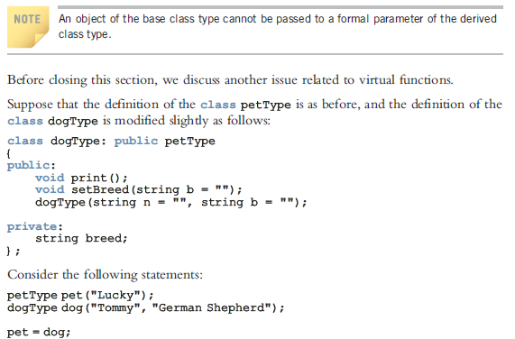
Passing derived class object as formal parameter to base class
C++ Programming: From Problem Analysis to Program Design, Sixth Edition
49

Slide 50
Classes and Virtual Destructors
Classes with pointer member variables should have the destructor
Destructor should deallocate storage for dynamic objects
If a derived class object is passed to a formal parameter of the base class type, destructor of the base class executes
Regardless of whether object is passed by reference or by value
Solution: use a virtual destructor (base class)
C++ Programming: From Problem Analysis to Program Design, Sixth Edition
50
Notes:
50

Slide 51
Classes and Virtual Destructors
class base
{
public:
~base()
{
cout << "Base destructor" << endl;
}
};
class derived :public base
{
~derived()
{
cout << "Derived destrcture" << endl;
}
};
int main()
{
base *p = new derived;
delete p;
return 0;
}
/*
Output:
Base destructor
*/
C++ Programming: From Problem Analysis to Program Design, Sixth Edition
51
Notes:
51

Slide 52
Classes and Virtual Destructors
class base
{
public:
virtual ~base()
{
cout << "Base destructor" << endl;
}
};
class derived :public base
{
~derived()
{
cout << "Derived destrcture" << endl;
}
};
int main()
{
base *p = new derived;
delete p;
return 0;
}
/*
Output:
Base destructor
Derived destructor
*/
C++ Programming: From Problem Analysis to Program Design, Sixth Edition
52
Notes:
52

Slide 53
Classes and Virtual Destructors (cont’d.)
Virtual destructor of a base class automatically makes the destructor of a derived class virtual
After executing the destructor of the derived class, the destructor of the base class executes
If a base class contains virtual functions, make the destructor of the base class virtual
C++ Programming: From Problem Analysis to Program Design, Sixth Edition
53
Notes:
53

Slide 54
Abstract Classes and Pure Virtual Functions
New classes can be derived through inheritance without designing them from scratch
Derived classes inherit existing members of base class
Can add their own members
Can redefine or override public and protected member functions
Base class can contain functions that you would want each derived class to implement
However, base class may contain functions that may not have meaningful definitions in the base class
C++ Programming: From Problem Analysis to Program Design, Sixth Edition
54
Notes:
54

Slide 55
Abstract Classes and Pure Virtual Functions (cont’d.)
Pure virtual functions:
Do not have definitions (bodies have no code)
Example: virtual void draw() = 0;
Abstract class: a class with one or more virtual functions
Can contain instance variables, constructors, and functions that are not pure virtual
Class must provide the definitions of constructor/functions that are not pure virtual
Note: - cannot create objects of that abstract class.
C++ Programming: From Problem Analysis to Program Design, Sixth Edition
55
Notes:
55

Slide 56
Abstract Classes and Pure Virtual Functions (cont’d.)
class shape
{
public:
virtual void draw() = 0;
};
class rectangle :public shape
{
void draw()
{ }
};
int main()
{
shape shape1;// Error: Object of Abstract class type "shape is not allowed :
//function "shape::draw" is pure virtual function
rectangle l;
return 0;
}
C++ Programming: From Problem Analysis to Program Design, Sixth Edition
56
Notes:
56

Slide 57
Abstract Classes and Pure Virtual Functions (cont’d.)
class shape
{
public:
virtual void draw() = 0;
};
class rectangle :public shape
{
};
int main()
{
shape shape1;// Error: Object of Abstract class type "shape is not allowed :
//function "shape::draw" is pure virtual function
rectangle l;
//rectanglel
// function "shape::draw" is pure virtual function
// Error: Object of Abstract class type "rectangle" is not allowed :
//function "shape::draw" is pure virtual function
return 0;
}
C++ Programming: From Problem Analysis to Program Design, Sixth Edition
57
Notes:
57

Slide 58
Address of Operator and Classes
& operator can create aliases to an object
Example:
int x;
int &y = x;
x and y refer to the same memory location
y is like a constant pointer variable
y = 25; sets the value of y (and of x) to 25
x = 2 * x + 30; updates value of x and y
C++ Programming: From Problem Analysis to Program Design, Sixth Edition
58
Notes:
58

Slide 59
Address of Operator and Classes (cont’d.)
Address of operator can also be used to return the address of a private member variable of a class
However, if you are not careful, this operation can result in serious errors in the program
C++ Programming: From Problem Analysis to Program Design, Sixth Edition
59
Notes:
59

Slide 60
Summary
Pointer variables contain the addresses of other variables as their values
Declare a pointer variable with an asterisk, *, between the data type and the variable
Address of operator (&)returns the address of its operand
Unary operator * is the dereferencing operator
Member access operator (->) accesses the object component pointed to by a pointer
C++ Programming: From Problem Analysis to Program Design, Sixth Edition
60
Notes:
60

Slide 61
Summary (cont’d.)
Dynamic variable: created during execution
Created using new, deallocated using delete
Shallow copy: two or more pointers of the same type point to the same memory
Deep copy: two or more pointers of the same type have their own copies of the data
Binding of virtual functions occurs at execution time (dynamic or run-time binding)
C++ Programming: From Problem Analysis to Program Design, Sixth Edition
61
Notes:
61

